Slide 1

Why Not Watch? Recommendation Engine Analysis
Critical Assessment & Business Recommendations
Michael Teixeira S4133975
Notes:
"Hi everyone. I'm Michael Teixeira, and today I'll be presenting what started as a routine analysis of our recommendation engine A/B test - but quickly became something much more critical.

Slide 2
Critical Assessment & Business Recommendations
KEY FINDINGS:
Algorithm shows 10.9% increase in viewing hours
Multiple severe methodological flaws discovered
Results unreliable for business decisions
RECOMMENDATION:
DO NOT roll out company-wide
Conduct proper randomized trial first.
IMPACT:
Prevents multi-million dollar mistake
Notes:
As you can see here, our new algorithm shows an impressive 10.9% increase in viewing hours. In our industry, that kind of improvement could translate to millions in additional advertising revenue. That's the exciting news.
However, during my analysis, I uncovered multiple severe methodological flaws that fundamentally change how we should interpret these results. What I'm about to share isn't just a statistical analysis - it's a business risk assessment that could prevent us from making a very costly mistake.
[PAUSE, LOOK AROUND ROOM] My clear recommendation to this team is: do not roll out this algorithm company-wide based on the current evidence. Let me show you exactly why."
[TRANSITION: "Let's start with why this analysis matters for our business..."]

Slide 3
Why This Analysis Matters
User engagement = advertising revenue
Hours watched per day = key performance metric
Algorithm changed July 18th at 00:01
Question: Does new algorithm increase viewing hours?
Notes:
"Before we dive into the data issues, let me remind everyone what's at stake here. [POINT TO SLIDE] In our streaming business model, user engagement directly equals revenue. Every additional hour watched means more advertising inventory, higher rates, and ultimately more profit.
Hours watched per day is our north star metric - it drives everything from advertiser relationships to content acquisition budgets. When we implemented this algorithm change on July 18th at one minute past midnight, we were specifically testing whether the new recommendation engine could increase this critical metric.
[LEAN FORWARD] The question seemed straightforward: does our new algorithm make users watch more content? As I'll show you, the answer is anything but straightforward."
[TRANSITION: "Now let me walk you through what we were supposed to be testing..."]

Slide 4
Study Details
Sample Size: 1,000 users
Time Period: July 1-31, 2023
Groups: A (Control) vs B (Treatment)
Key Variables: Age, gender, social score, viewing hours
Algorithm Change: July 18th, 00:01
Expected Design: 50/50 randomized A/B test
Notes:
"Here's what our study was designed to look like. [GESTURE TO TABLE] We have 1,000 users tracked throughout July with comprehensive demographic data - age, gender, social engagement scores, and of course, daily viewing hours.
The plan was a standard A/B test: randomly assign users to either the old recommendation system or the new one, then compare their viewing behavior. Industry best practice would be roughly equal groups, proper randomization, and concurrent testing.
[PAUSE] What I found was dramatically different from this ideal. In fact, what I discovered fundamentally changes everything."
[TRANSITION: "And this brings me to the first critical issue I uncovered..."]

Slide 5
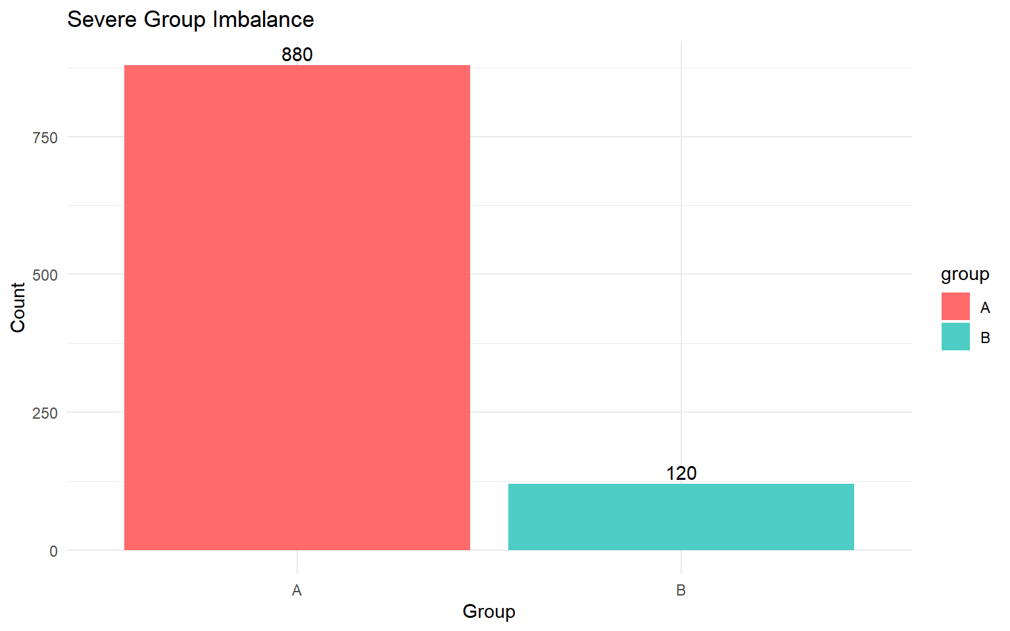
🚨 Severe Group Imbalance Discovered
Group A (Control): 880 users (88%)
Group B (Treatment): 120 users (12%)
Ratio: 7.33 to 1 imbalance
IMPACT:
❌ Reduces statistical power
❌ Violates A/B testing best practices
❌ Creates unreliable results
Notes:
"[VOICE MORE SERIOUS] Here's where things get concerning. Instead of the expected 50-50 split, look at these numbers. [POINT TO CHART] We have 880 users in Group A and only 120 in Group B. That's an 88% to 12% split - a 7.33-to-1 imbalance.
[SHAKE HEAD] This is a major red flag in experimental design. Proper A/B testing requires balanced groups to achieve adequate statistical power. When you have this kind of imbalance, your confidence intervals become unreliable, your effect estimates become unstable, and your conclusions become questionable.
[PAUSE] But honestly, this was just the beginning. What I found next completely changed my understanding of what we're dealing with here."
[TRANSITION: "Because when I looked at the timing of this data, I discovered something shocking..."]

Slide 6
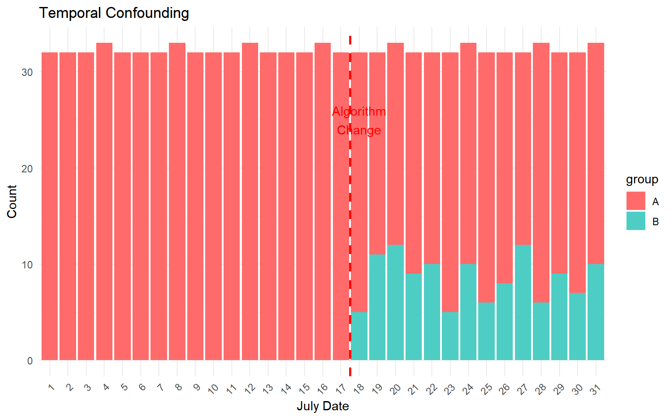
🚨 This is NOT a Randomized A/B Test
❌ ALL data before July 18th = Group A only
❌ Group B only appears from July 18th onwards
❌ This is a BEFORE/AFTER comparison, not A/B test
MAJOR RISK:
Algorithm effect confused with:
Seasonal trends
External factors
Time-based changes
Notes:
"[LEAN IN, SERIOUS TONE] Ladies and gentlemen, this is the smoking gun that changes everything. [POINT TO TIMELINE] When I analyzed when each group appears in our data, I discovered that ALL - and I mean ALL - of the control group data comes from before July 18th. The treatment group only appears from July 18th onwards.
[LET THIS SINK IN] What this means is that we don't have a randomized A/B test. We have a before-and-after comparison. Users weren't randomly assigned to old versus new algorithms - they're separated by time.
Think about what this means for our results. [COUNT ON FINGERS] The 11% increase we're seeing could be due to seasonal viewing patterns, summer vacation behaviors, popular content releases during the treatment period, external events, competitor actions - basically anything that changed between early July and late July.
[DIRECT EYE CONTACT] We cannot isolate the algorithm effect from these time-based confounding factors. This is a fundamental violation of experimental design principles."
[TRANSITION: "And the bias issues don't stop there. Let me show you how different these groups actually are..."]

Slide 7
🚨 Severe Demographic Bias
Characteristic | Group A | Group B | Difference
Average Age | 36.2 | 38.9 | +2.7 years
% Female | 45.5% | 24.2% | -21.3%
Social Score | 4.87 | 5.22 | +7.2% higher
Male % | 54% | 76% | +22% more
PROBLEM: Treatment group has higher-engagement users to begin with
Notes:
"Now we get to the demographic bias, and it's substantial. [GESTURE TO TABLE] Look at these differences. The treatment group is nearly 3 years older on average, has 21% fewer women, and has significantly higher baseline engagement scores.
[EMPHASIZE] This is critical because it means the treatment group was predisposed to higher engagement even before they got the new algorithm. They're not just different in time - they're different in their fundamental characteristics as users.
So when we see higher viewing hours in the treatment group, we have to ask: is it because of our algorithm, or because we're comparing highly engaged users to a broader, more diverse user base? [PAUSE] Based on this data, we simply cannot tell."
[TRANSITION: "Now let's look at what the raw numbers actually show us..."]

Slide 8
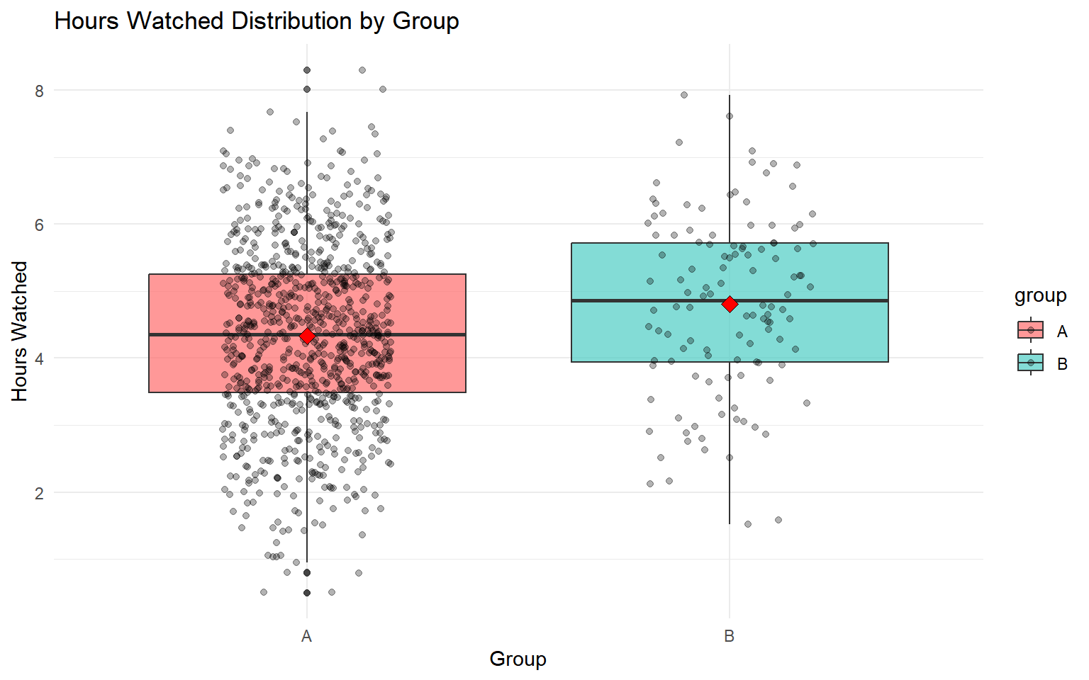
Primary Analysis Results
Group A Mean: 4.336 hours/day
Group B Mean: 4.811 hours/day
Difference: +0.475 hours (+10.9%)
P-value: < 0.05 (significant)
Notes:
"Here are the results that initially looked so promising. [POINT TO NUMBERS] Group B shows 4.81 hours per day versus 4.34 for Group A - that's our 10.9% increase. The p-value is less than 0.05, so it's statistically significant.
[PAUSE, LOOK UP] But given everything I've just shown you about group imbalance, temporal confounding, and demographic bias, this statistical significance is essentially meaningless for business decision-making.
[GESTURE TO CHART] The boxplot shows the distribution, and yes, there's a visible difference. But we now know this difference is contaminated by multiple sources of bias."
[TRANSITION: "Let me show you some alternative explanations for what we're seeing..."]

Slide 9
Alternative Explanations for "Improvement"
🌞 Seasonal Effects: Summer viewing patterns
📺 Content Releases: Popular shows during treatment
👥 User Selection: More engaged users got new algorithm
📈 Time Trends: Natural platform growth
🏢 External Events: Competitor actions, news events
BOTTOM LINE: Cannot isolate algorithm effect
Notes:
"So if it's not necessarily the algorithm driving this improvement, what could it be? [POINT TO EACH BULLET] Summer viewing patterns are different from spring patterns. Popular shows might have been released during the treatment period. The treatment group had more engaged users to begin with.
We might be seeing natural platform growth, competitor actions that drove users to our service, or major news events that increased overall streaming consumption during late July.
[SERIOUS TONE] The fundamental problem is that without proper randomization and concurrent groups, we cannot separate the algorithm effect from any of these alternative explanations. And in business, that uncertainty is incredibly expensive."
[TRANSITION: "I did try to control for some of these factors statistically..."]

Slide 10
Controlling for Bias - Effect Shrinks
Model Type | Algorithm Effect | P-Value
Simple (Biased) | +0.475 hours | 0.005
Adjusted | +0.312 hours | 0.018
Effect drops 34% when controlling for bias
Remaining effect could still be confounding
Notes:
"I attempted to control for the demographic differences through regression analysis. [POINT TO TABLE] When I include age, gender, social engagement, and other variables in the model, the algorithm effect drops from 0.475 hours to 0.312 hours - that's a 34% reduction.
This tells us that a significant portion of what we attributed to the algorithm was actually due to demographic differences between the groups. [PAUSE] But even this smaller effect could still be explained by the temporal confounding I showed you earlier.
The bottom line: statistical controls can't fix fundamental design flaws."
[TRANSITION: "Now let me put this in business terms that matter for our decision..."]

Slide 11
Risk of Rolling Out Based on Flawed Data
If Algorithm is... | | Roll Out? | Outcome
Effective | Proceed | ✅ Revenue increase
Ineffective | Proceed | ❌ Wasted resources
Harmful | Proceed | ❌ User churn, revenue loss
Current Evidence Quality: Too poor to distinguish scenarios
Business Risk: Multi-million dollar decision on flawed data
Notes:
"Let's think about this as a business decision with real financial consequences. [POINT TO SCENARIO TABLE] If we roll out this algorithm and it's actually effective, great - we see revenue increases. But if we roll out and it's ineffective or even harmful, we could be looking at significant losses.
[LEAN FORWARD] Here's the critical point: the current evidence quality is too poor to distinguish between these scenarios. We're essentially gambling with potentially millions of dollars based on fundamentally flawed data.
And if we're wrong, we won't know it immediately. It could take months of declining engagement before we realize we've made a mistake. By then, we might have lost users to competitors, damaged our recommendation reputation, and missed opportunities to implement actually effective improvements."
[TRANSITION: "So how does our study compare to industry standards?"]

Slide 12
Our Study vs A/B Testing Standards
Best Practice | Standard | Our Study | Status
Group Balance | 50/50 | 88/12 | ❌ Failed
Randomization | Random | Before/after | ❌ Failed
Sample Size | Power-based | No calculation | ❌ Failed
Baseline Period | Required | None | ❌ Failed
External Controls | Monitor | Not controlled | ❌ Failed
SCORE: 0/5 - Violates every A/B testing principle
Notes:
"I evaluated our study against the five fundamental principles of A/B testing. [POINT TO SCORECARD] Group balance: we failed with our 88-12 split. Randomization: we failed with our before-after design. Sample size planning: we failed - no power analysis was conducted. Baseline period: we failed - no pre-treatment measurement. External controls: we failed - no monitoring of confounding factors.
[PAUSE FOR EFFECT] That's zero out of five. We violated every single principle of proper experimental design.
No reputable technology company would make a major strategic decision based on evidence this flawed."
[TRANSITION: "Which brings me to my clear recommendation..."]

Slide 13
RECOMMENDATION: DO NOT ROLL OUT
❌ DO NOT roll out algorithm company-wide
RATIONALE:
Evidence quality insufficient for major decision
High risk of false positive result
Potential significant revenue loss if wrong
Confidence in Current Results: Very Low (<30%)
Required Action: Proper randomized trial
Notes:
"[CONFIDENT, DIRECT TONE] My recommendation to this executive team is unambiguous: do not roll out this algorithm company-wide based on the current evidence.
The risk is simply too high. We have less than 30% confidence in these results given the methodological flaws I've outlined. [PAUSE] In business, we need high-confidence evidence for high-stakes decisions.
[GESTURE FORWARD] What we need is a proper randomized controlled trial that will give us reliable, actionable insights."
[TRANSITION: "And I have a specific proposal for how we do this right..."]

Slide 14
Proper A/B Test Design - 7 Week Plan
Phase 1: Design (2 weeks)
Equal groups (400 per group minimum)
True randomization
Pre-specified analysis plan
Phase 2: Execute (4 weeks)
Concurrent groups (no before/after)
Monitor external factors
Regular balance checks
Phase 3: Analysis & Decision (1 week)
Notes:
"Here's my proposed path forward. [POINT TO TIMELINE] A three-phase approach over seven weeks total.
Phase one: two weeks to design the proper study. This means determining adequate sample sizes through power analysis, implementing true randomization stratified by key demographics, and creating a pre-specified analysis plan so we're not making decisions based on data mining.
Phase two: four weeks of data collection with concurrent groups - no more before-and-after comparisons. We'll monitor external factors and conduct regular balance checks to ensure our randomization is working.
Phase three: one week for analysis and decision-making based on clean, reliable data.
[PAUSE] Yes, this represents a seven-week delay. But it's far better than making a costly mistake based on flawed evidence."
[TRANSITION: "Let me address the resource requirements..."]

Slide 15
Investment vs Risk
New Study Investment: | ~$50,000
Timeline: | 7 weeks
Resources: | Data engineering, analytics, product
Risk of Wrong Decision: | $Millions in lost revenue
Timeline if Wrong: | 6+ months to realize and fix
Competitive Impact: | Significant if algorithm ineffective
VS
Notes:
"The investment is modest compared to the risk we're mitigating. [POINT TO NUMBERS] We're talking about roughly $50,000 over seven weeks, requiring some data engineering time, analytics support, and product team coordination.
Compare that to the millions of dollars at risk if we make the wrong decision. [PAUSE] If this algorithm is ineffective and we roll it out company-wide, we could spend months implementing, optimizing, and supporting a system that's actually hurting user engagement.
The math is clear: investing in proper methodology now protects us from much larger losses later."
[TRANSITION: "Let me close with the specific next steps..."]

Slide 16
Action Plan & Next Steps
This Week:
1. ✋ HALT current rollout plans
2. 📋 Approve proper A/B test design
3. 👥 Assign project team
Strategic Decision:
Accept 7-week delay for reliable evidence
Build robust experimentation capabilities
Expected Outcome: Confident algorithm decision by Q3 end
Notes:
"[CONFIDENT, AUTHORITATIVE TONE] Here are the three immediate actions I recommend this week. First, halt current rollout plans. We need to pause any implementation activities until we have reliable evidence.
Second, approve the proper A/B test design I've outlined. Assign the necessary resources and establish clear project ownership.
Third, commit to this strategic approach: accept a seven-week delay in exchange for high-confidence evidence that will guide not just this decision, but establish robust experimentation capabilities for future algorithm improvements.
[FINAL PAUSE, LOOK AROUND ROOM] The question isn't whether we can afford to wait seven weeks. The question is whether we can afford to guess with millions of dollars at stake.
[CONFIDENT CLOSE] Better to be right in seven weeks than wrong today. Thank you for your attention, and I'm ready to answer any questions about the technical details or implementation plan."

